Slide 1
Public Bank Deposit Analysis

Slide 2
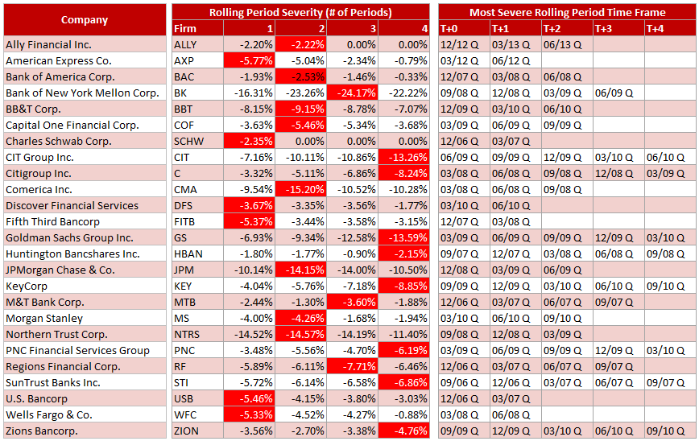
Public bank deposit analysis
Per the discussion in the closure meeting, the following slides provide additional information behind the appendix “Rolling Period Severity” tables.
The table to the right presents all of banks that were considered for the analysis. For the purpose of this review, we will only look at Bank of New York Mellon Corp (BK).

Slide 3
Data source Public bank deposit analysis
Data for the analysis was sourced from SNL.com, an S&P Global Market Intelligence company.
Publically available Y9C reports were used
Deposits were aggregated and represent the total deposits of an institution
Balances are quarterly
The following examples are samples of that data

Slide 4
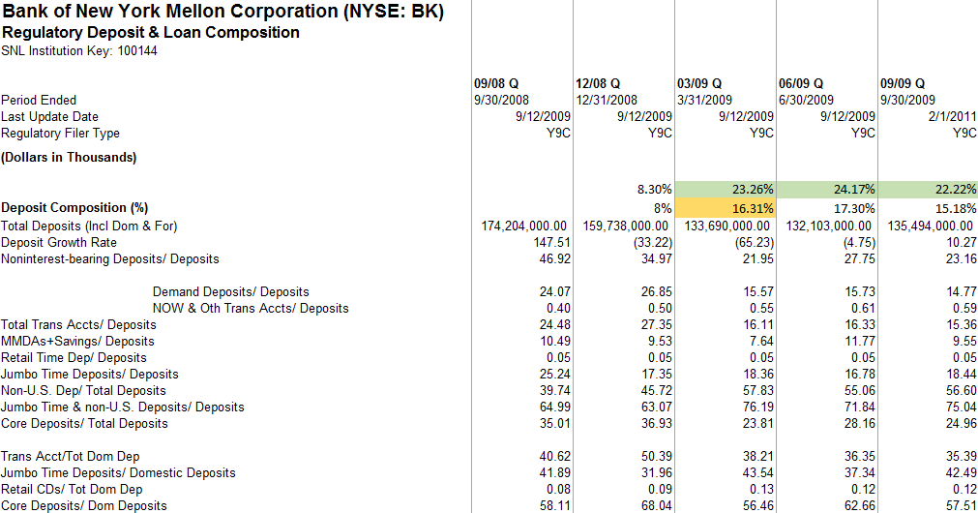
BK Y9C Public bank deposit analysis
The highlighted data in green shows the consecutive quarters with the greatest percentage decline since the beginning of the declining period after 09/08
Range of consecutive depressed balance quarters
Worst consecutive quarters

Slide 5
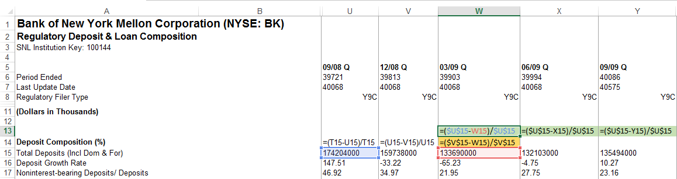
Calculation Public bank deposit analysis
09/08 represents the beginning period of deposit outflows in this example
The formulas in the green shading are returning the change in deposits from 09/08 and represent the worst quarters as a percentage of decline since the 09/08
The formula in yellow shading is returning the change in deposits from the prior month which began the worst consecutive periods of severity from 09/08
Although deposits declined from 09/08 to 12/08, the following three quarters from 03/09 to 09/09 were more severe and were thus included in the analysis

Slide 6
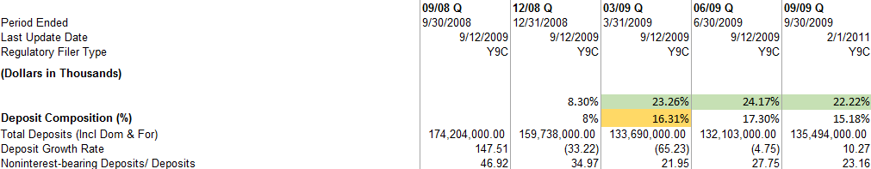
Calculation Public bank deposit analysis
Rolling Period Severity - Period # 1 -16.31% is the change in deposits from 12/08 to 03/09
Rolling Period Severity - Period # 2 -23.26% is the change in deposits from the beginning of the declining period, 09/08, and so on through Period # 4
Rolling Period Severity - Period # 3 -24.17%, highlighted in bright red represents the period of greatest deposit decline since the depressed period began

Slide 7
Calculation Public bank deposit analysis
T+0 = The quarter that began a period of deposit outflow
In the BK example T+4 is not included in the “Most Severe Rolling Period Time Frame” table because deposits grew from the prior period although they were still down 22.22% since the begging of the outflow period 09/08

